Slide 1
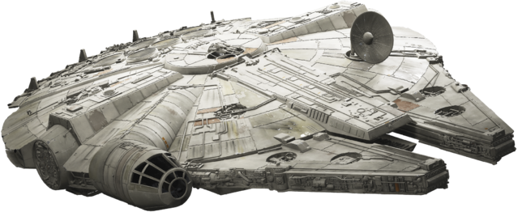

MIKAYLA BARDWELL, CORA HANSEN, MYLES TERRY, AND ALEXIS WEIGEL
SAVE THE EMPIRE
ONE IMPERIAL CREDIT PREDICTION AT A TIME

Slide 2



THE PROBLEM
KEY MEMBERS OF THE EMPIRE’S ANALYTICS TEAM WERE TAKEN CAPTIVE BY THE REBELS
?
WHO IS GOING TO PREDICT THE IMPERIAL CREDIT FOR THE NEXT 12 MONTHS?!?
WE ARE!!!

Slide 3

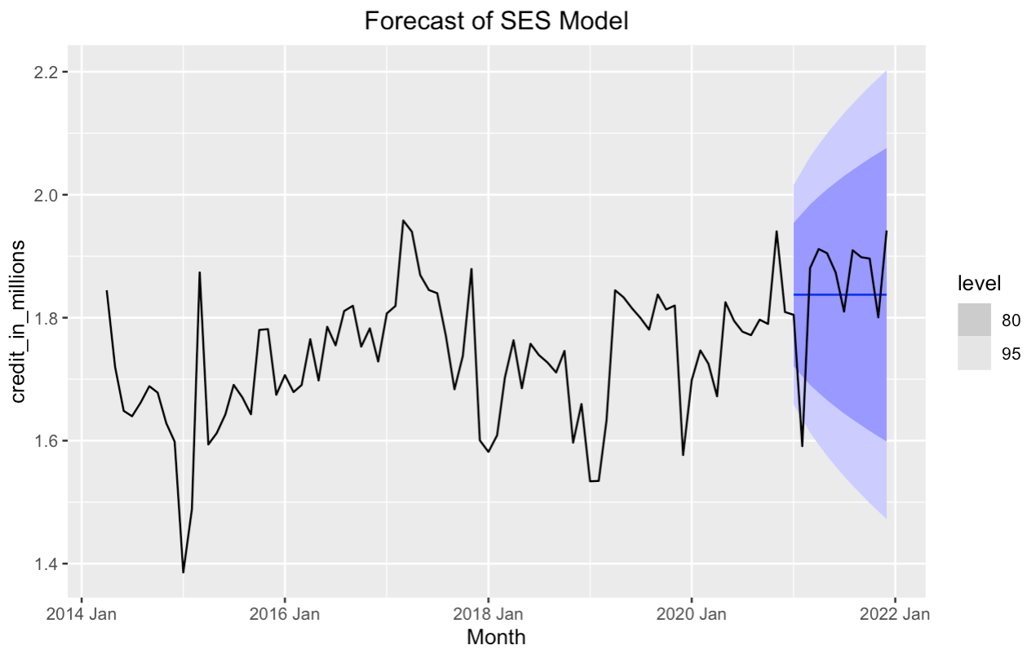
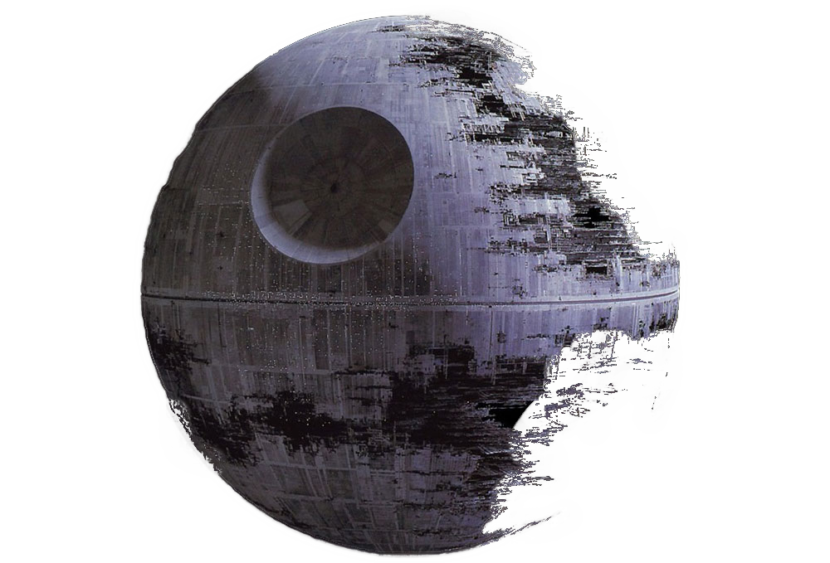
The model that tempted us with the dark side
SIMPLE EXPONENTIAL SMOOTHING MODEL
Forecasts are calculated using weighted averages, where the weights decrease exponentially as observations come from further in the past. The prediction intervals show that there is some uncertainty in the future credit over the 12-month forecast period. So, interpreting the point forecasts without accounting for the uncertainty can be somewhat misleading.
SES = ETS(credit_in_millions~ error("A") + trend("N") + season("N"))

Slide 4
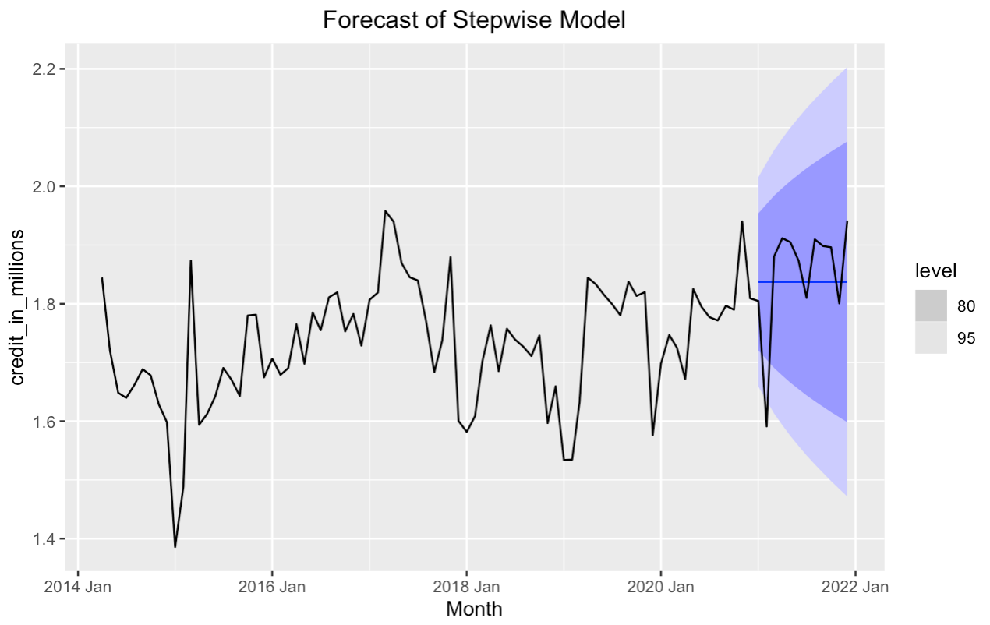

The model that PRACTICED THE FORCE
STEPWISE MODEL
The stepwise model goes through the past values of the dataset and predicts solely based on any patterns that it notices when it goes through it. It is useful when forecasting data if one is to assume that the future will be relatively the same as the past and is often used in technical analysis. However, it will struggle to accurately forecast any major changes down the road.
stepwise = ARIMA(credit_in_millions)

Slide 5

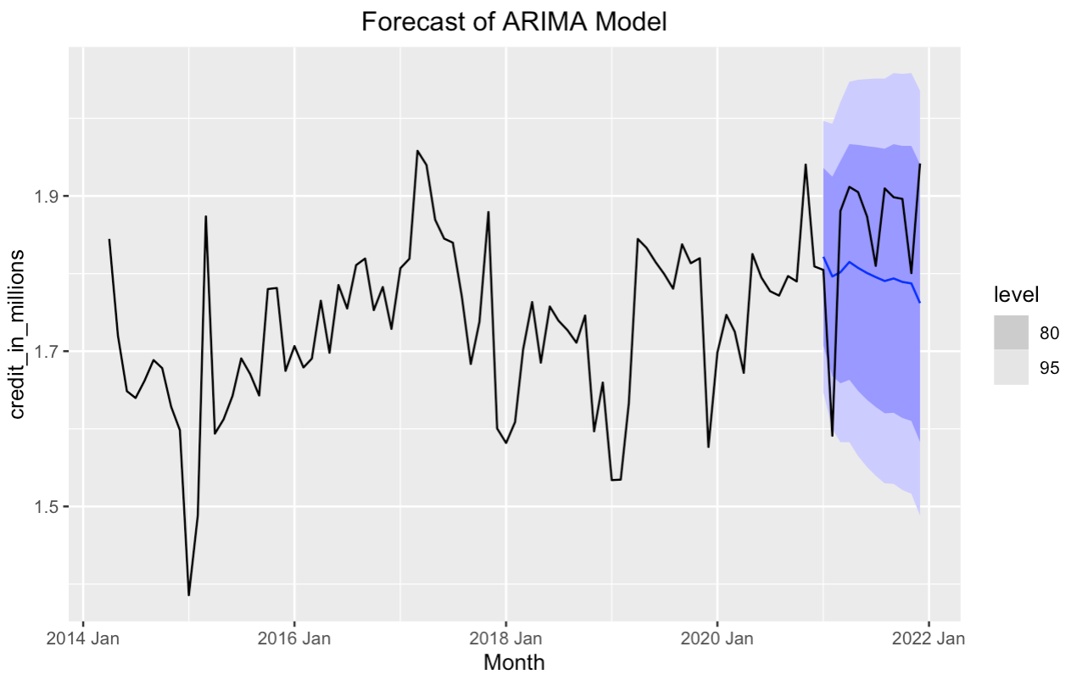

ONE WITH THE FORCE THE MODEL THAT IS
ARIMA MODEL
The ARIMA model works to improve upon the stepwise in the sense that it goes through more “tests” until it is certain that it has found the best model it can happen upon. It uses an algorithm to predict future values from past values. It creates many models through this algorithm and uses the best one it can find, unlike the stepwise model which happens to take shortcuts to get there. However, it also has the downfall of being able to handle data that it different upon its past values.
ARIMA = ARIMA(credit_in_millions, stepwise = FALSE, approximation = FALSE)

Slide 6



THE GALACTIC EMPIRE WILL LIVE TO PREDICT ANOTHER DAY!

